Slide 1
UCSD: Data Bootcamp ETL Project
Team Members: Francis Yu, Chris Ng, Cris Bangaoil, Chetan Balachanda

Slide 2
Goal Statement:
Determine California areas with a high amount of Data Science job openings.
Compare salaries in California areas
Which sites have more Data Science job listings
Keyword Analysis for most in-demand skills from current open Data Science Jobs

Slide 3




Data Sources

Slide 4
Scraped Data
For each of the 4 career sites we will search for Data Science jobs in California:
Job Title
Company
Location
Salary (if available)
Job Description
URL to each job listing

Slide 5
Methodology
Scrape each site for the data fields
Create DataFrames for Job Listings
Remove Duplicate listings if Job Title and Company are the same
Clean Entries, Remove formatting and extra information
Convert DataFrames to and Load dictionaries into a MongoDB collection
Run Data Analysis use various Python libraries, i.e, Pandas, MatPlotLib
Load Analysis into a website via Flask

Slide 6
Challenges
Selecting the sources that can pull all the required fields
Filtering duplicates from each individual site and then removing the duplicate postings across the various sites
Salary information is not always provided in the listings
Running into Catchas while scraping data

Slide 7
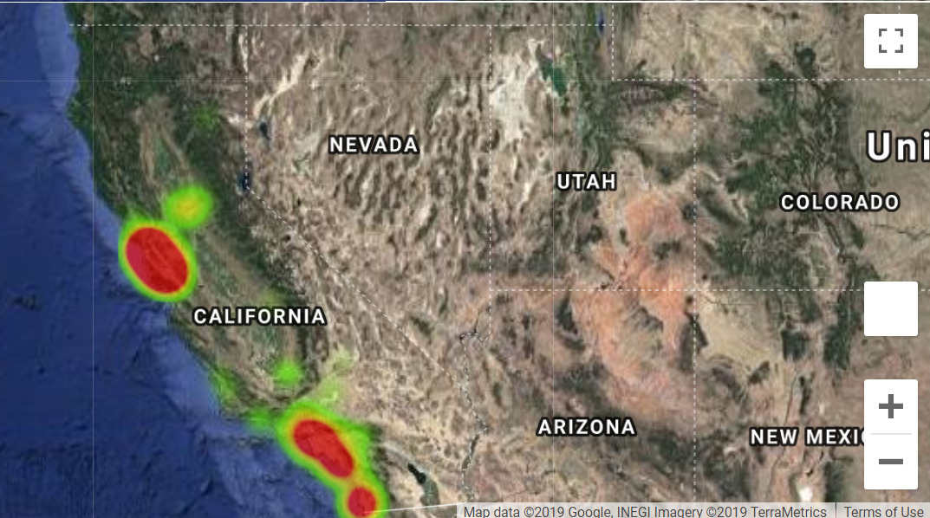
Where should you move to
Heat map of current Data Science openings in California

Slide 8
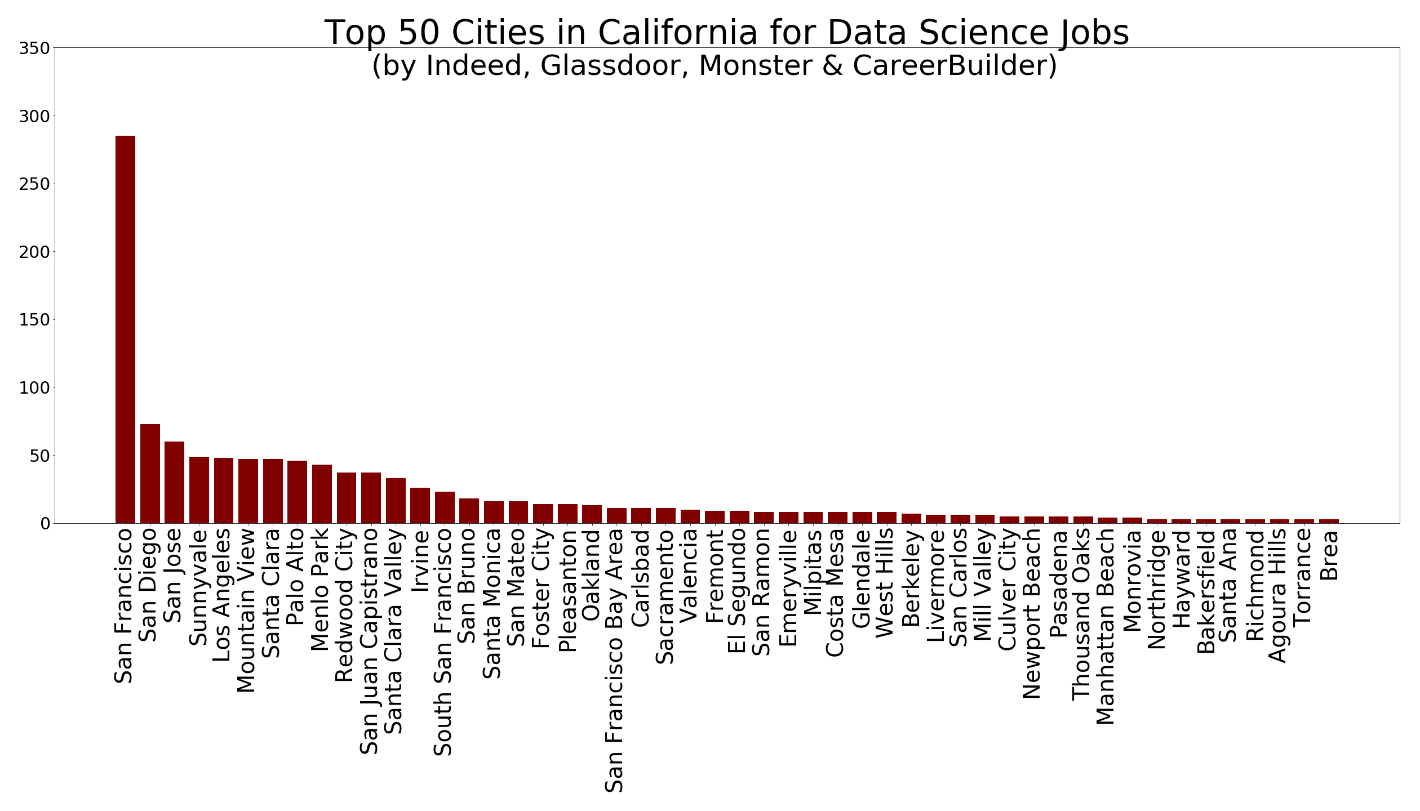
Where should you move to cont.
Job distribution in top 50 cities in California that return most data science jobs

Slide 9
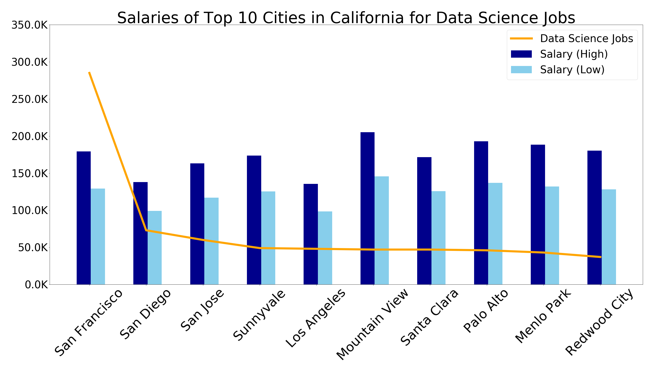
Where should you move for the Money
Combines job frequency data with average salaries per city

Slide 10
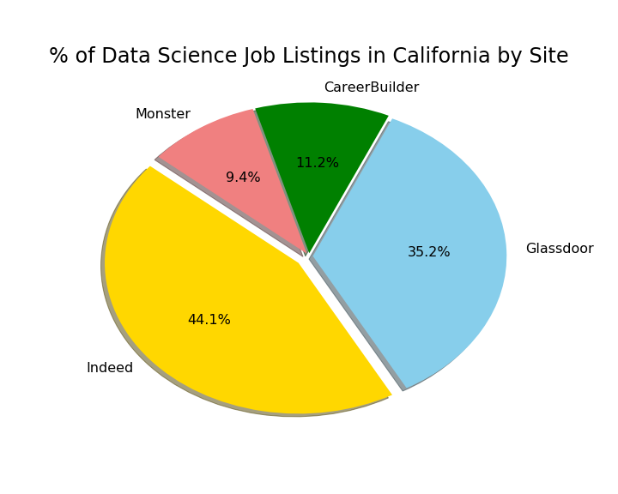
Which site should you visit most
Pie chart of data science jobs of the 4 sources

Slide 11
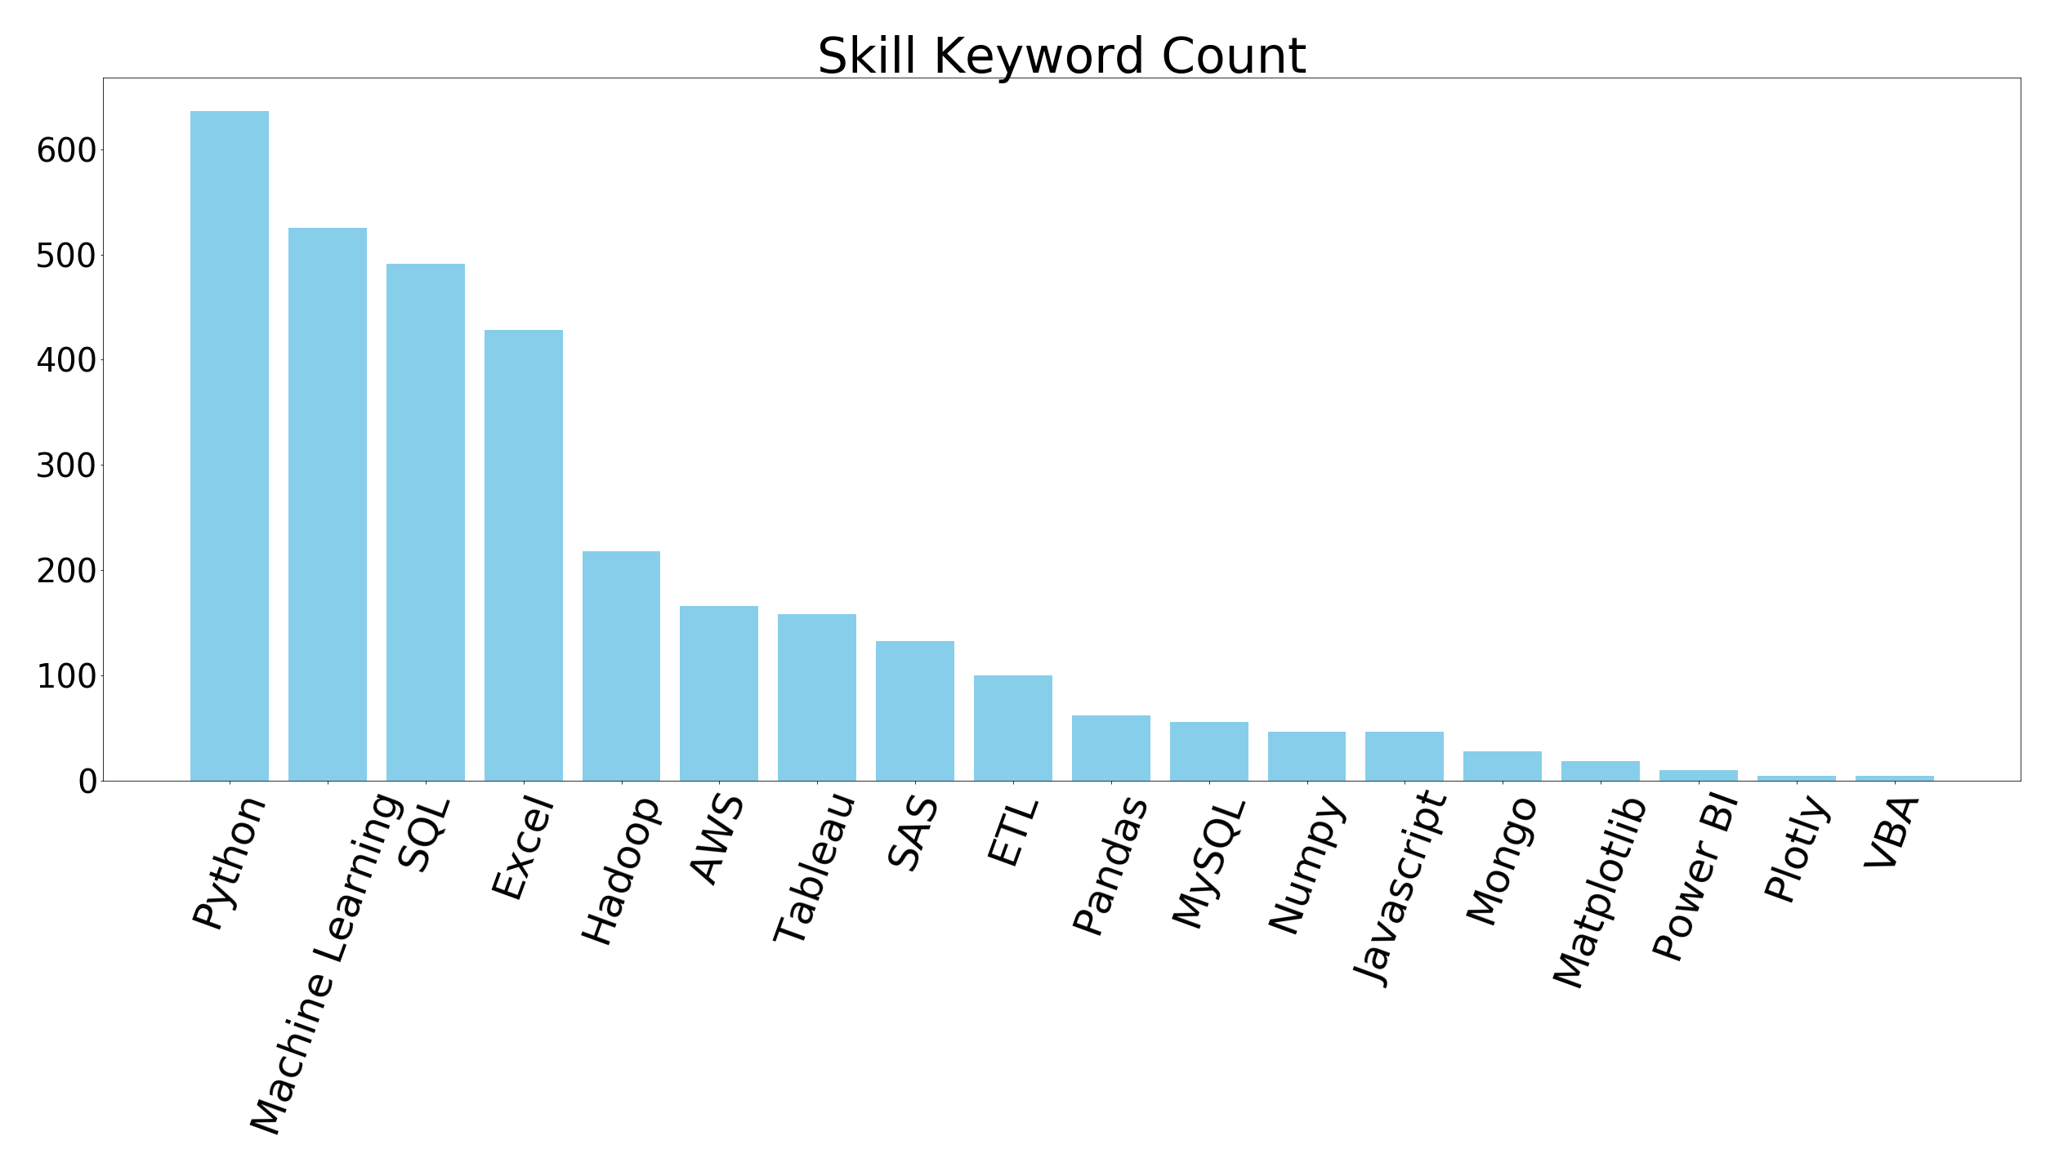
Popular keywords
Popular Keyword frequency in current Data Science job openings

Slide 12
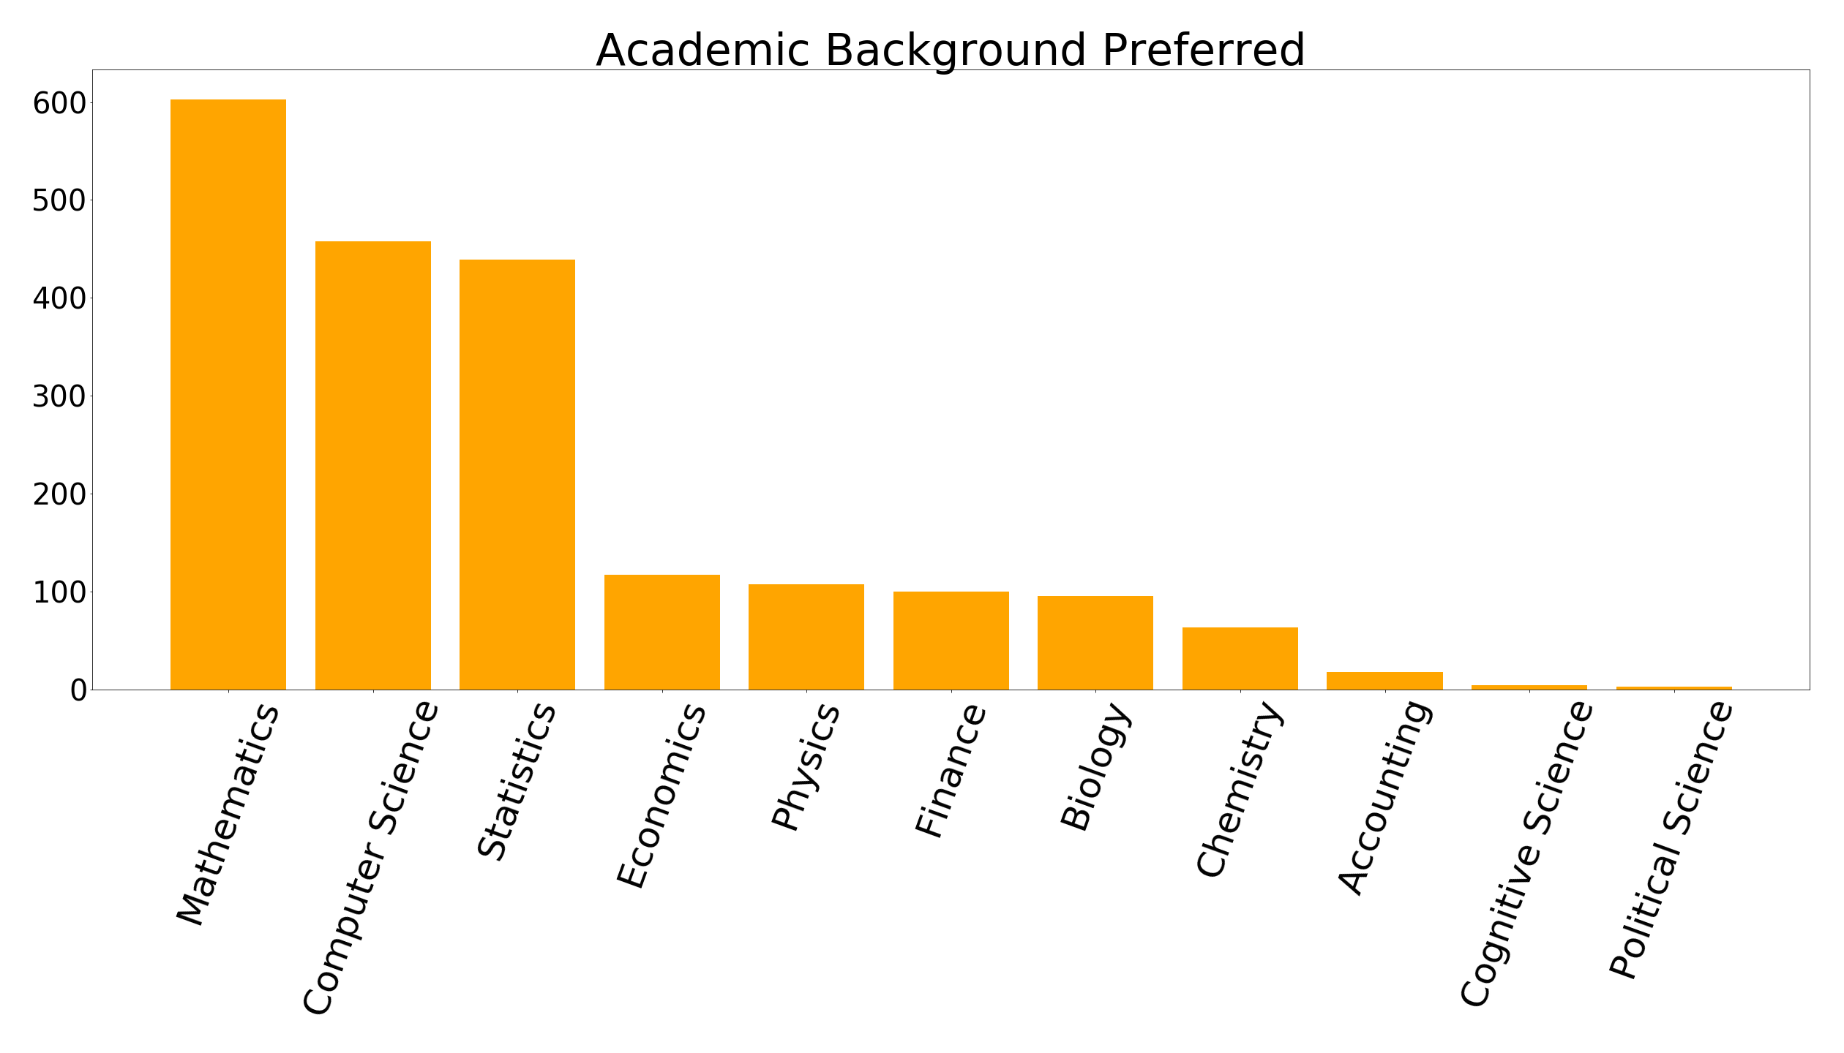
Backgrounds Preferred
Academic keyword frequency in current Data Science job openings

Slide 13
Conclusions
Surprise! Move to the Bay Area
Data Scientists are most wanted in SF, Bay Area and LA, San Diego. Not many openings in Central California
Get paid (and then increase your expenditures)
Data Scientists get paid highest in Bay Area, and higher in NorCal than SoCal.
Set job alerts on Glassdoor and Indeed
Make sure you put the following on your resumes:
Python, Machine Learnings, SQL, Excel, Hadoop

Slide 14
Limitations
We only include keywords of “Data Scientist” and “Data Science.” Other relevant keywords could be “Data Analyst”, “Research Analyst”
Glassdoor treated data scraping as a breach of their terms and services. This limited our search for descriptions from their website.
Our original vision was to create a web application that scraps and returns the combined results of the most recent job listings from Glassdoor, Indeed, Monster and CareerBuilder. However the current tools and method we use are too slow and cause too much delay, thus not practical.

